Slide 1
Model Talk, Eps. 3
Let’s talk about the reading…

Slide 2
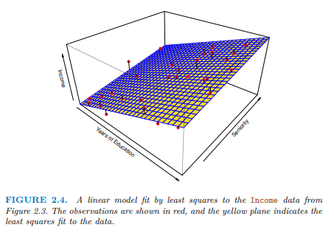
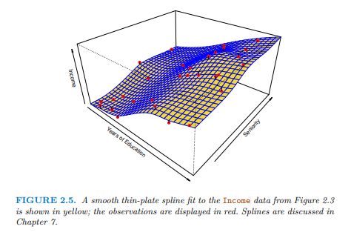

Slide 3
Data and Variables

Slide 4

Sources of Data
Definitions:
A population is the entire group of objects or individuals under study, about which information is wanted.
Data are observations (such as measurements or survey responses) taken from members of a population.
A census is the collection of data from every element in a population.
A sample is a subset of a population that is actually observed and used to get information.

Slide 5
Caveat: Almost all data we see come from samples!
Reason:
It would take too much time and money to study the entire population.
May even not be feasible.

Slide 6
Definitions
A parameter is a numerical measurement describing some characteristic of a population.
A statistic is a numerical measurement describing some characteristic of a sample.

Slide 7
Examples
Determine whether the given collection is a population or a sample:
The labor force for the United States and its average wage
People polled to judge the standing of the Presidential election
This class answers a survey which is used to infer how the student body views the Data Analytics curriculum
This class answers a survey which is used to infer how this section of DATA 180 is going

Slide 8
Examples
Determine whether the given value is a parameter or a statistic:
All current Dickinson students' records are examined and 17% of them are found to be international students.
The median weekly wage of full-time workers is $1,143
The percent of people found to support a presidential candidate in a new poll is 51%
Several Domino sugar packs are randomly selected, and the average weight of the contents is 3.65 g.
Domino’s restaurants serve over 1 million people per day

Slide 9
Representative Samples
Statistical inference is when we draw conclusions based on our data.
Fundamental Rule for Using Sample Data for Inference
Samples can be used to make inferences about a population only if the data can be considered to be representative with regard to the question(s) of interest.
Random sampling
Population
Sample
Inferential Statistics

Slide 10
Definitions
Definition: A unit or object is an item we observe. When the unit is a person, we refer to the unit as a subject.
Definition: An observation is a piece of information or characteristic recorded for each unit.
Definition: A characteristic that can vary from unit to unit is called a variable.
Definition: A set of observations on one or more variables from a collection of units is called a data set.

Slide 11
Variable Types
Definition: Categorical (qualitative) variables are those which classify the units into categories. The categories may or may not have a natural ordering to them.
Example: Education level (high-school, college,…)
Definition: A numeric (quantitative) variable is one that measures a numerical characteristic.
Example: Years of education since first grade
A discrete variable can only consist of integer values,
e.g., N = {1, 2, 3, …}
A continuous variable can take on any value within a given interval. e.g., 1.5088039, 5, 693.84975 …

Slide 12
Variable Types
Categorical variables come in two types:
An ordinal variable is a qualitative variable whose categories have a natural ordering to them.
Example: Titanic’s ticket classes
A nominal variable is a qualitative variable whose categories have no natural ordering to them.
Example: Nationality, hometown, gender

Slide 13
Examples for Types of Variables
Categorical
Ordinal
Nominal
Numeric
Discrete
Continuous
Movie Rating
Yes/No (binary i.e. 0-1 variable)
Eye color
Time to react to a stimulus
Candidate chosen in last election
Melting point
Number of elevators in a building

Slide 14
Examples for Types of Variables
Categorical
Ordinal
Nominal
Numeric
Discrete
Continuous
Time to run the 100-meter dash
Blood type
Drink size (S M L) at a restaurant
Number of women in the Senate
An individual's ZIP code

Slide 15
Model Talk, Eps. 4
Let’s work on some more examples…

Slide 16
Multivariate Data Sets
It is often the case that more than one variable is measured for each unit. That is, each unit has a vector of observations associated with it. These variables can be of any of the types discussed previously.
Examples:
Patients have height, weight, and waist size recorded.
Units:
Variables:
b) Students have SAT score, High school average, and First-Year GPA measured.
c) Anthropologists make five measurements on skulls unearthed at a dig site.
Units:
Variables:
Units:
Variables:

Slide 17
Data Matrices
If we are given data on n units, each possessing p variables of interest. Then the n x p data matrix for this collection is the rectangular array given by
Data Matrix:
Variables
Var 1
Var j
Var p
Units
Unit 1
Unit i
i ^{th} unit
j ^{th} variable
Unit n
Matrices are usually denoted with bold capital letters A, B, X.

Slide 18
Data Matrix
Sample of Crime data for 2007, scaled to rate per 100,000 population.
 |  | Pop | Violent crime | Murder | Rob- bery | Aggra- vated assault | Property crime | Burglary | Larceny- theft | Motor vehicle theft | Arson
Buffalo | 2007 | 273,832 | 1,275 | 20 | 560 | 635 | 5,893 | 1,603 | 3,461 | 829 | 43
New York | 2007 | 8,220,196 | 614 | 6 | 265 | 332 | 1,819 | 254 | 1,403 | 161 | 68
Rochester | 2007 | 206,686 | 1,133 | 24 | 497 | 552 | 5,419 | 1,238 | 3,388 | 794 | 98
Syracuse | 2007 | 139,880 | 1,026 | 14 | 319 | 646 | 4,264 | 1,276 | 2,587 | 401 | 34
Yonkers | 2007 | 198,071 | 443 | 5 | 214 | 202 | 1,521 | 324 | 1,007 | 190 | 18
This information can be condensed into the following data matrix.
X =

Slide 19
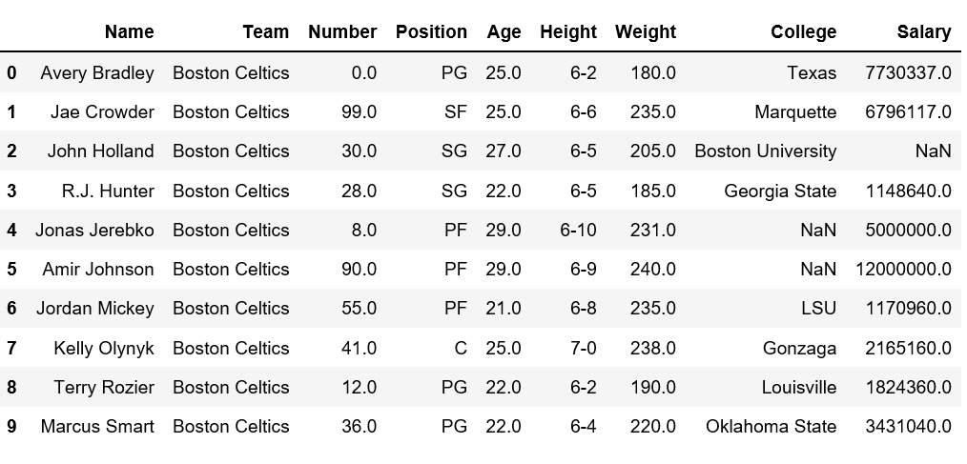
Data Frames in R
The basic structure for storing multivariate data in R is the data frame. This is a tightly coupled collection of variables which share many of the properties of matrices and of lists and is used as the fundamental data structure by most of R’s modeling software.
A data frame is a matrix-like structure whose columns may be of differing variable types (numeric, factor, logical, and so on).
Note: The function class can be used to see what the class of a particular object stored in R is (very useful!)

